Slide 1

Project Details:
Project Title - Forecasting Air Quality Using Historical Pollution Data
Project Purpose - To predict AQI and pollutant levels using historical pollution data and support healthier, data-driven decisions. The system
provides alerts, dashboards, and trend analysis to help authorities and the public take timely preventive actions.
Tools and Technologies - Python (Pandas, NumPy, Matplotlib, Sci-kit Learn) for data analysis and forecasting, and Streamlit for building the
interactive dashboard and UI.
Mentor - Ms. Umme Asma S
Batch Number - 3
Start Date - 22-September-2025
Intern Name – Pala Jyothi Akshaya
GitHub Repository - https://github.com/itsakshaya/Infosys6.0_Python_Batch3

Slide 2
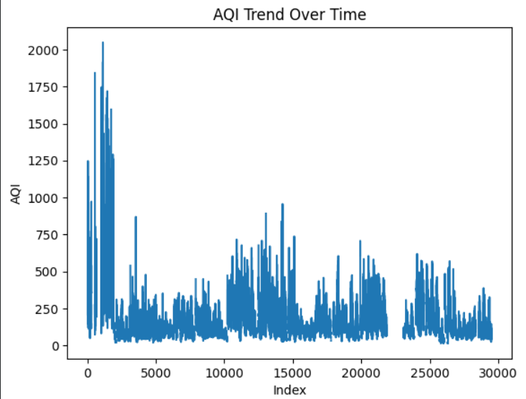
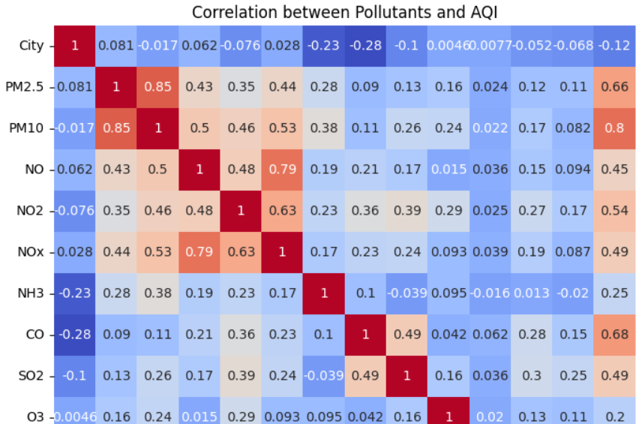
MILESTONE1: Data Preprocessing & EDA

Slide 3
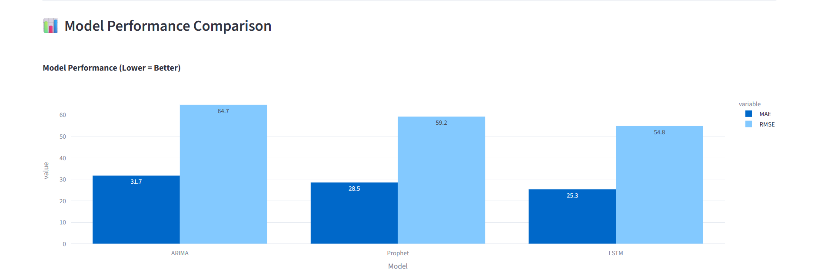
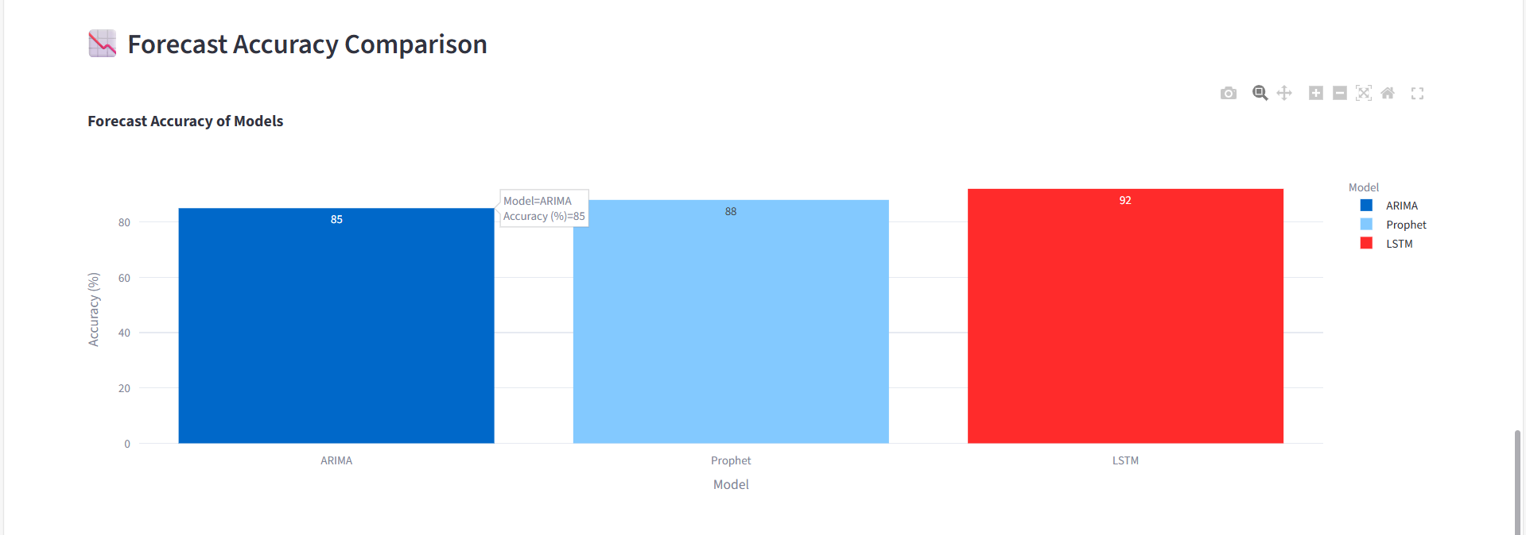
MILESTONE2: Model Training & Evaluation

Slide 4
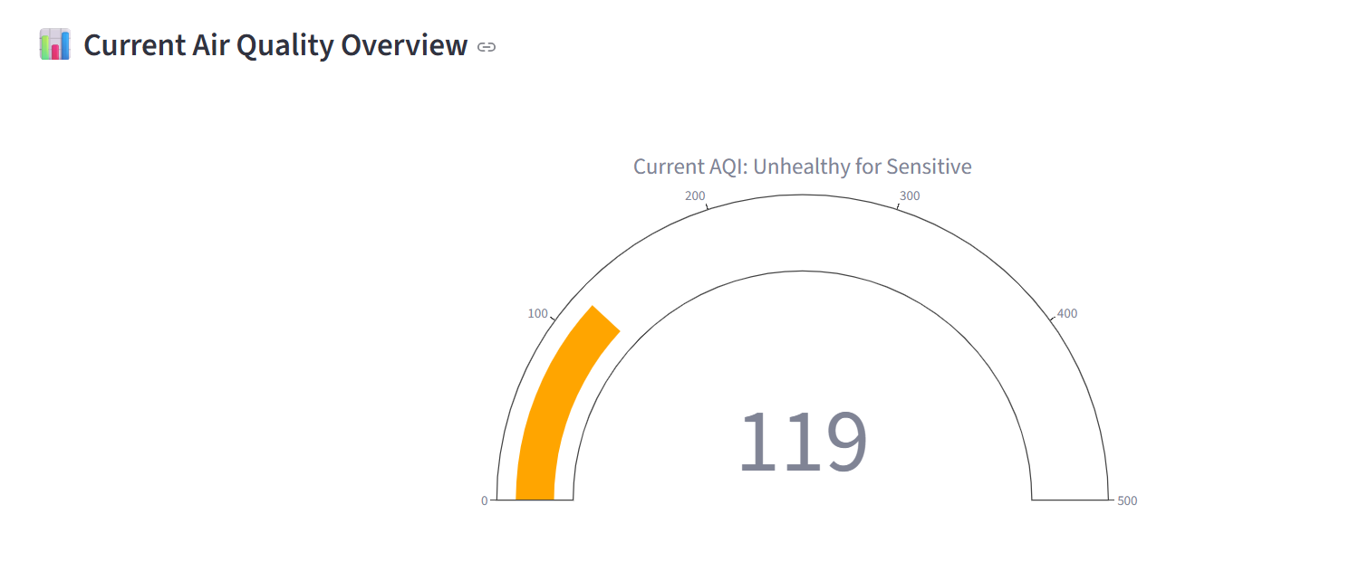
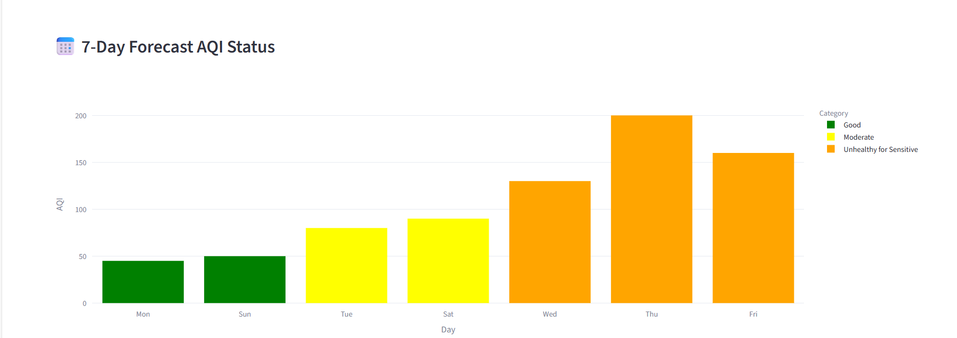
MILESTONE3: Alert Logic & Trend Visualization

Slide 5
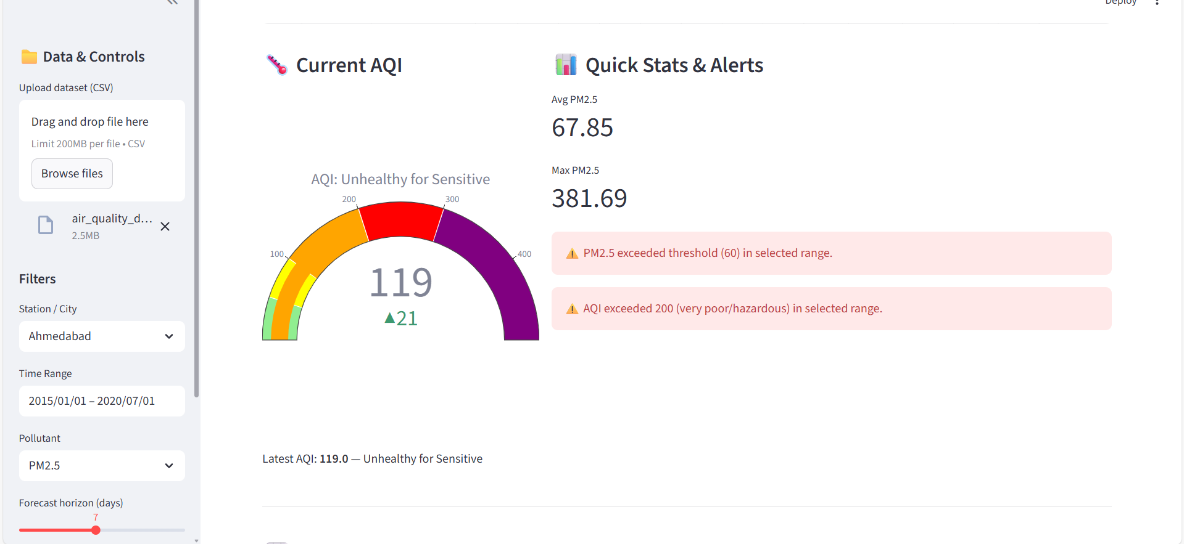
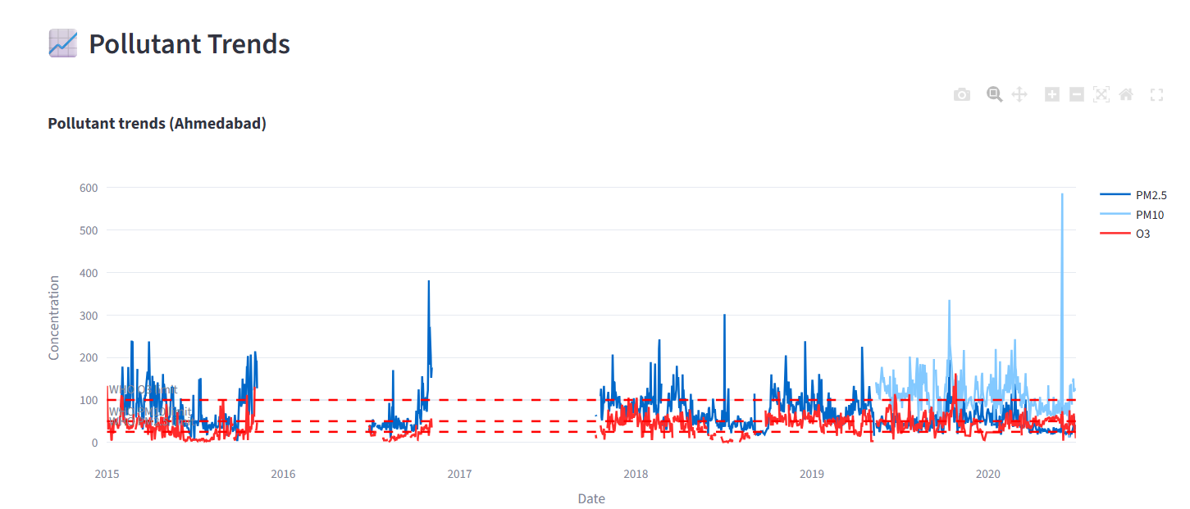
MILESTONE4: Streamlit Dashboard

Slide 6
STEPS TO RUN THE PROJECT (INDIVIDUAL MILESTONES)
Milestone | File to Run | Command | Purpose / What Happens
M1 – Data Explorer | M1_Data_Explorer.py | streamlit run M1_Data_Explorer.py | Opens the Data Explorer dashboard → Upload dataset → View filters, charts, EDA.
M2 – Forecast Engine | M2_Forecast_Engine.py | streamlit run M2_Forecast_Engine.py | Shows ARIMA / Prophet / LSTM forecasts, model comparison, metrics.
M3 – Alert System | M3_Alert_System.py | streamlit run M3_Alert_System.py | Displays AQI gauge, pollutant chart, 7-day alerts.
M4 – Final Dashboard | M4_Final_Dashboard.py | streamlit run M4_Final_Dashboard.py | Full integrated dashboard with admin mode, trends, forecast & uploads.

Slide 7


